Slide 1
School Rooms
Back To School

Slide 2
Classroom

Slide 3
2 Timothy 2:15
Be diligent (Study) to present yourself approved to God

Slide 4
Acts 8:30–31
“Do you understand what you are reading?”
“How can I, unless someone guides me?”

Slide 5
2 Timothy 3:16
…instruction in righteousness,

Slide 6
Cafeteria

Slide 7
John 4:34
“My food is to do the will of Him who sent Me”

Slide 8
Matthew 5:6
Blessed are those who hunger and thirst for righteousness, For they shall be filled.

Slide 9
John 6:35
“I am the bread of life. He who comes to Me shall never hunger, and he who believes in Me shall never thirst.”

Slide 10
John 6:27
Do not labor for the food which perishes, but for the food which endures to everlasting life, which the Son of Man will give you, because God the Father has set His seal on Him.”

Slide 11
Cafeteria

Slide 12
John 4:34
“My food is to do the will of Him who sent Me”

Slide 13
Matthew 5:6
Blessed are those who hunger and thirst for righteousness, For they shall be filled.

Slide 14
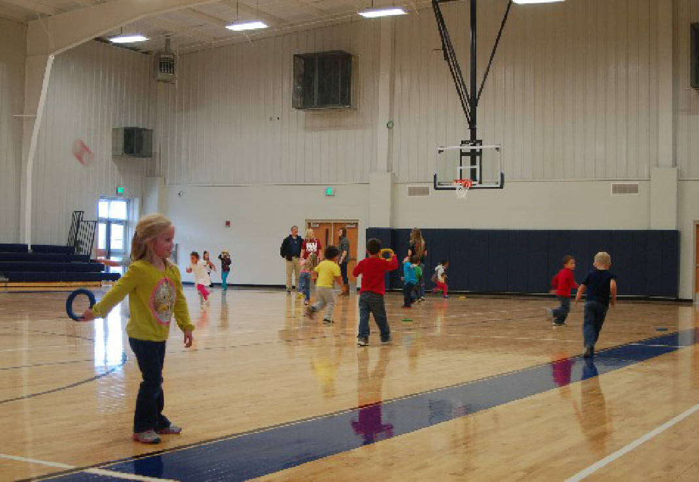
Gymnasium

Slide 15
1 Timothy 4:7–8
exercise yourself toward godliness. For bodily exercise profits a little, but godliness is profitable for all things

Slide 16
Luke 6:40
A disciple is not above his teacher, but everyone who is perfectly trained will be like his teacher.

Slide 17
Principal’s Office

Slide 18
1 Timothy 6:12
Fight the good fight of faith, lay hold on eternal life, to which you were also called and have confessed the good confession in the presence of many witnesses.

Slide 19
Hebrews 10:31
It is a fearful thing to fall into the hands of the living God.

Slide 20
Other Rooms
Rest Room, Supply Room,
Boiler Room, Wash Room

