Slide 1
New Life In Christ
Discover

Slide 2
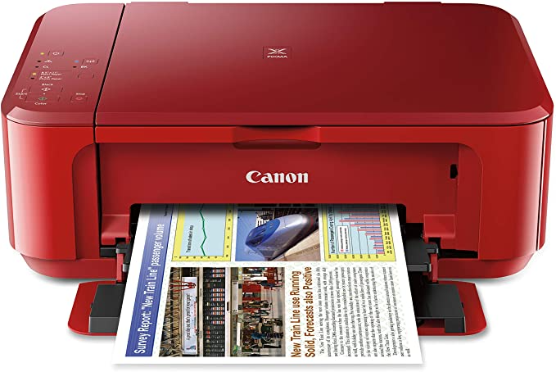

Slide 3
New Thinking
In Christ

Slide 4
Ephesians 4:22–24
Be renewed in the spirit of your mind, and that you put on the new man which was created according to God, in true righteousness and holiness.

Slide 5
Acts 10:28
“You know how unlawful it is …

Slide 6
Acts 10:28
Galatians 6:15 For in Christ Jesus neither circumcision nor uncircumcision avails anything, but a new creation.
Galatians 5:6 For in Christ Jesus neither circumcision nor uncircumcision avails anything, but faith working through love.

Slide 7
Galatians 6:15
For in Christ Jesus neither circumcision nor uncircumcision avails anything, but a new creation.

Slide 8
Galatians 5:6
For in Christ Jesus neither circumcision nor uncircumcision avails anything, but faith working through love.

Slide 9
New Being
In Christ

Slide 10
Romans 6:4
…that just as Christ was raised from the dead by the glory of the Father, even so we also should walk in newness of life.

Slide 11
2 Corinthians 5:17
Therefore, if anyone is in Christ, he is a new creation; old things have passed away; behold, all things have become new.

Slide 12
Matthew 5:3-11
Be humble
Be sorry for sinful behavior
Be teachable
Be hungry for the right things
Be merciful
Be pure in heart
Be a peacemaker
Be persecuted for righteousness

Slide 13
New Doing
In Christ

Slide 14
Romans 7:6
But now we have been delivered from the law, having died to what we were held by, so that we should serve in the newness of the Spirit and not in the oldness of the letter.

Slide 15
1 Peter 4:4
In regard to these, they think it strange that you do not run with them in the same flood of dissipation, speaking evil of you.

